Slide 1
Food tree level argument
.

Slide 2
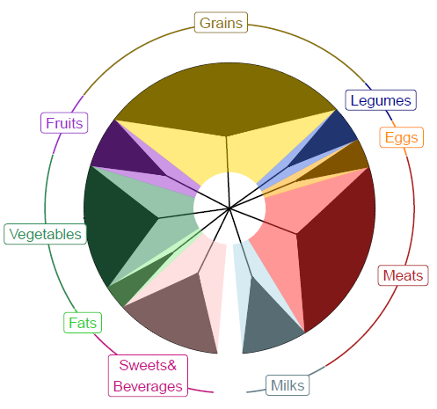
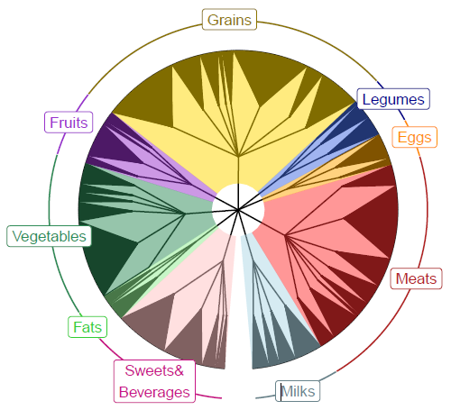
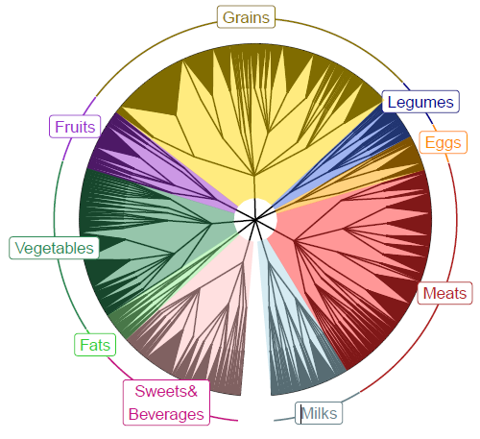
The level argument in food tree
1274 food items were reported by the subpopulation, males 60-79.
The level argument in make.food.tree is how much detailed classification (taxonomy info) you would like to have within your tree.
Lv 1
Lv 2
Lv 3
A nice figure to add to our preprint (Abby)

Slide 3
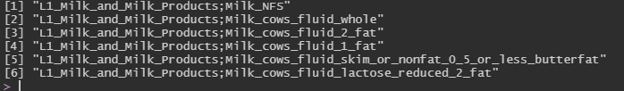
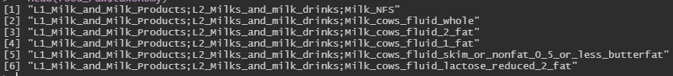
taxonomy column in Food OUT table
males60to79_red_Lv1.dhydrt.otu.txt (1274 tips and 10 internal nodes)
males60to79_red_Lv2.dhydrt.otu.txt (1274 tips and 54 internal nodes)
males60to79_red_Lv3.dhydrt.otu.txt (1274 tips and 210 internal nodes)
Actually the number of leaves (food products) is the same across all levels. The number of branches inside the tree is different. The levels argument specifies how much detailed classification of each food items to include in your tree.

Slide 4
Count the number of food items at each level
L1 | L1 count
L1: Milk | 74
L1: Vegetables | 200
L1: Carb | 1000
Total | 1274
L1 | L1 count | L2 | L2 count
L1: Milk | 74 | L2: Milk fluid | 70
 |  | L2: Milk solid | 4
L1: Vegetables | 200 | L2: Green | 100
 |  | L2: Root | 100
L1: Carb | 1000 | L2: Wheat | 800
 |  | L2: Rice | 200
Total | 1274 |  | 1274
Make a function to do this if I had extra time.

